Slide 1


Skin Anatomy and physiology
Dr. Mahdi H. Hammadi
PhD Sc. Clinical Physiology

Slide 2
Skin Anatomy and physiology
Integumentary system composed from:
skin
accessory structures (hair and nail)

Slide 3
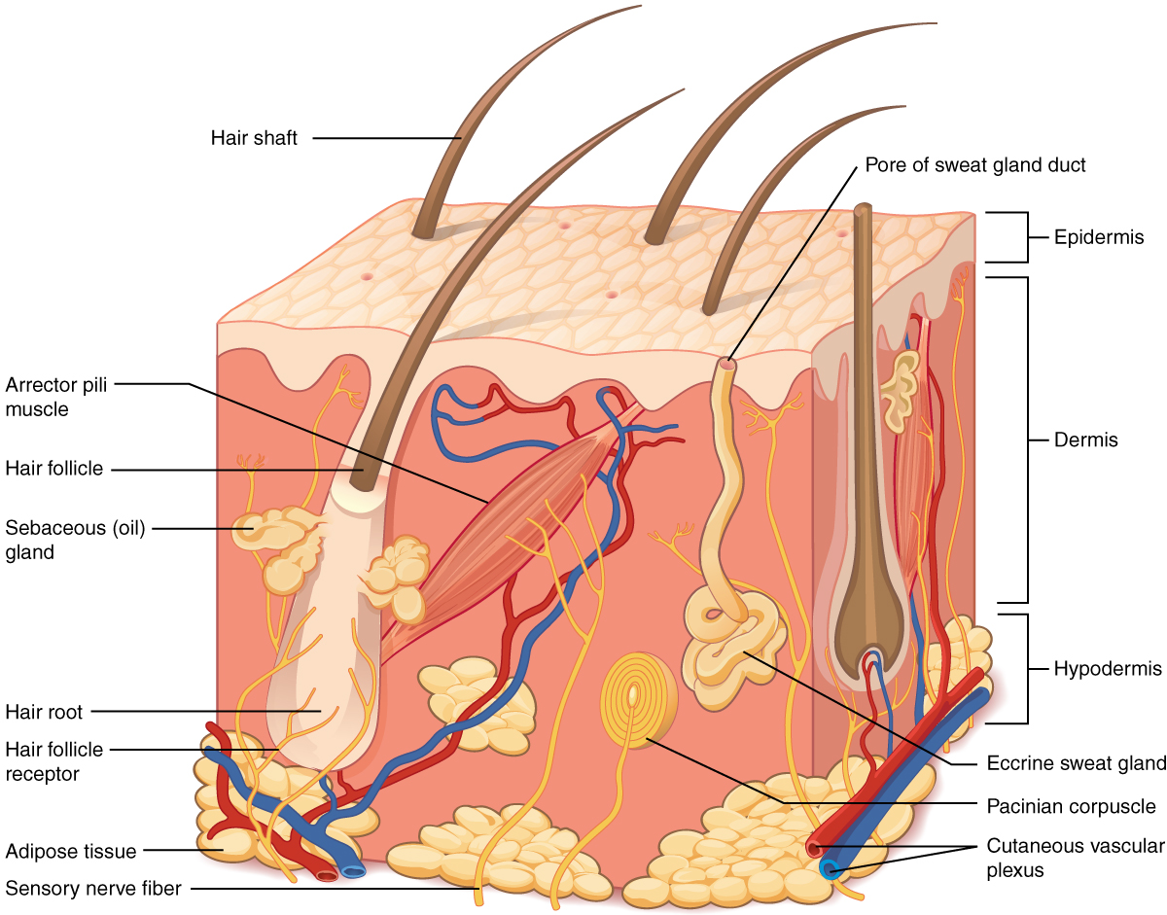

Slide 4
The skin consists of two main layers and a closely associated layer.
1- The Epidermis
The epidermis is composed of:
Keratinized, stratified squamous epithelium.
It is made of four or five layers of epithelial cells, depending on its location in the body. It does not have any blood vessels within it (i.e., it is avascular).
Skin that has four layers of cells is referred to as “thin skin.” From deep to superficial, these layers are the

Slide 5
stratum basale
stratum spinosum
stratum granulosum
Stratum corneum.
Most of the skin can be classified as thin skin.
“Thick skin”
Is found only on the palms of the hands and the soles of the feet.
It has a fifth layer, called the stratum lucidum, located between the stratum corneum and the stratum granulosum (Figure 2).

Slide 6
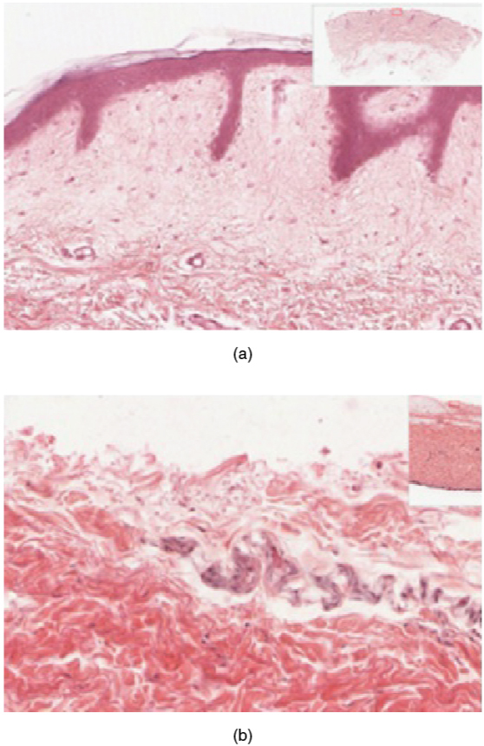

Slide 7
Stratum Basale
The stratum basale (also called the stratum germinativum) is the deepest epidermal layer and attaches the epidermis to the basal lamina, below which lie the layers of the dermis.
The cells in the stratum basale bond to the dermis via intertwining collagen fibers, referred to as the basement membrane.
A finger-like projection, or fold, known as the dermal papilla is found in the superficial portion of the dermis.
Dermal papillae increase the strength of the connection between the epidermis and dermis

Slide 8
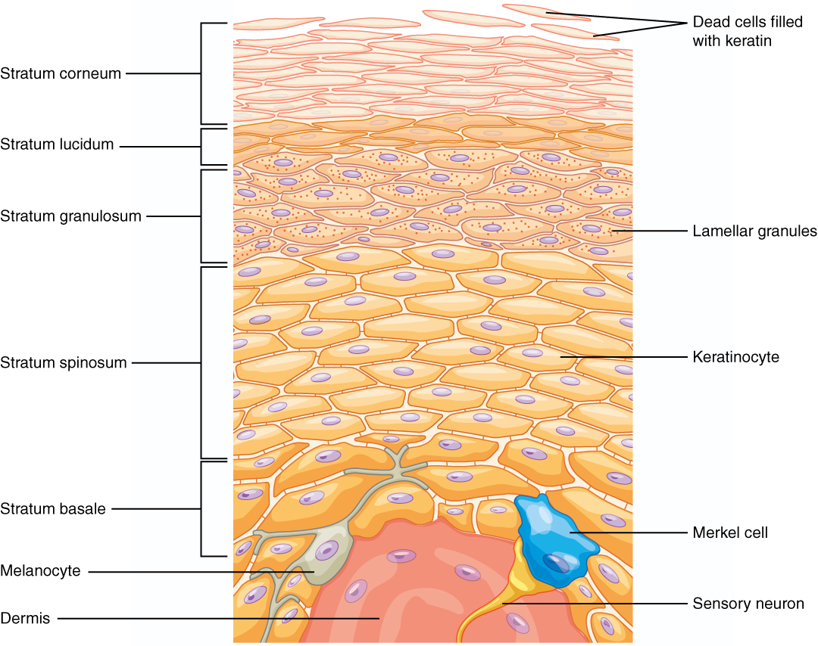

Slide 9
Figure 4. Layers of the Epidermis. The epidermis of thick skin has five layers: stratum basale, stratum spinosum, stratum granulosum, stratum lucidum, and stratum corneum.

Slide 10
The stratum basale
Is a single layer of cells primarily made of basal cells.
A basal cell is a cuboidal-shaped stem cell that is a precursor of the keratinocytes of the epidermis.
Two other cell types are found in the stratum basale.
Merkel cell, which functions as a receptor and is responsible for stimulating sensory nerves that the brain perceives as touch. These cells are especially abundant on the surfaces of the hands and feet.
melanocyte, a cell that produces the pigment melanin. Melanin gives hair and skin its color, and also helps protect the living cells of the epidermis from ultraviolet (UV) radiation damage

Slide 11
Stratum Spinosum
The stratum spinosum is spiny in appearance due to present structure called a desmosome.
The stratum spinosum is composed of 8 to 10 layers of keratinocytes
Formed as a result of cell division in the stratum basale .
In this layer is found dendritic cell called the Langerhans cell, which functions as a macrophage by engulfing bacteria, foreign particles, and damaged cells that occur in this layer.
The keratinocytes in the stratum spinosum begin the synthesis of keratin and release a water-repelling glycolipid that helps prevent water loss from the body, making the skin relatively waterproof.
As new keratinocytes are produced atop the stratum basale, the keratinocytes of the stratum spinosum are pushed into the stratum granulosum.

Slide 12
Stratum Granulosum
The stratum granulosum has a grainy appearance due to further changes to the keratinocytes as they are pushed from the stratum spinosum
(three to five layers deep)
The cells become flatter,
Their cell membranes thicken,
And they generate large amounts of the proteins keratin,
keratin , and keratohyalin, which accumulates as lamellar granules within the cells (see Figure 4). These two proteins make up the bulk of the keratinocyte mass in the stratum granulosum and give the layer its grainy appearance.

Slide 13
Stratum Lucidum
The stratum lucidum is a smooth, seemingly translucent layer of the epidermis located just above the stratum granulosum and below the stratum corneum.
found only in the thick skin of the palms, soles, and digits.
The keratinocytes are dead and flattened.
These cells are densely packed with eleiden

Slide 14
Stratum Corneum
Superficial layer of the epidermis and is the layer exposed to the outside environment.
The increased keratinization (also called cornification) of the cells in this layer gives it its name.
There are usually 15 to 30 layers of cells in the stratum corneum.
Dry, dead layer

Slide 15
2- Dermis
The dermis might be considered the “core” of the integumentary system
It contains blood and lymph vessels, nerves, and other structures, such as hair follicles and sweat glands.
The dermis is made of two layers of connective tissue that compose an interconnected mesh of elastin and collagenous fibers, produced by fibroblasts

Slide 16
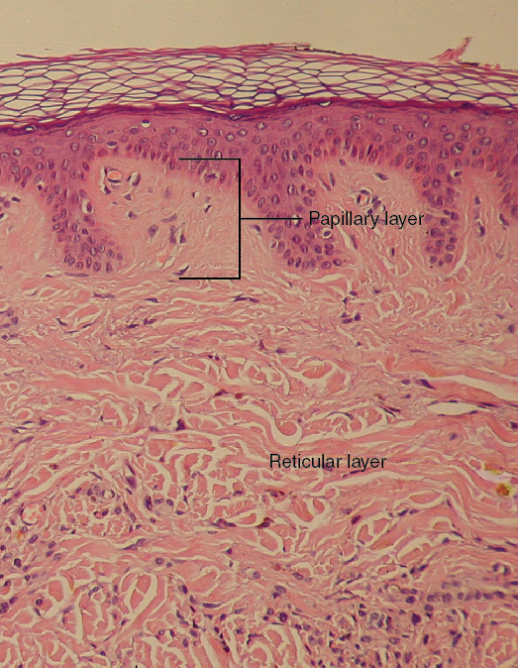
Figure 6. Layers of the Dermis

Slide 17
Papillary Layer
The papillary layer is made of loose, areolar connective tissue, which means the collagen and elastin fibers of this layer form a loose mesh.
This superficial layer of the dermis projects into the stratum basale of the epidermis to form finger-like dermal papillae

Slide 18
the papillary layer are contain:
fibroblasts,
a small number of fat cells (adipocytes)
Small blood vessels.
The papillary layer contains phagocytes, defensive cells that help fight bacteria or other infections that have breached the skin

Slide 19
Reticular Layer
Underlying the papillary layer is the much thicker reticular layer, composed of dense, irregular connective tissue.
This layer is well vascularized and has a rich sensory and sympathetic nerve supply.
The reticular layer appears reticulated (net-like) due to a tight meshwork of fibers. Elastin fibers provide some elasticity to the skin .
Collagen fibers provide structure and tensile strength. In addition, collagen binds water to keep the skin hydrated.
Collagen injections and Retin-A creams help restore skin turgor by either introducing collagen externally or stimulating blood flow and repair of the dermis, respectively.

Slide 20
Hypodermis
The hypodermis (also called the subcutaneous layer or superficial fascia) is a layer directly below the dermis and serves to connect the skin to the underlying fascia (fibrous tissue) of the bones and muscles.
It is not strictly a part of the skin, although the border between the hypodermis and dermis can be difficult to distinguish.
The hypodermis consists of well-vascularized loose, areolar connective tissue and adipose tissue, which functions as a mode of fat storage and provides insulation and cushioning for the integument.

